Slide 1
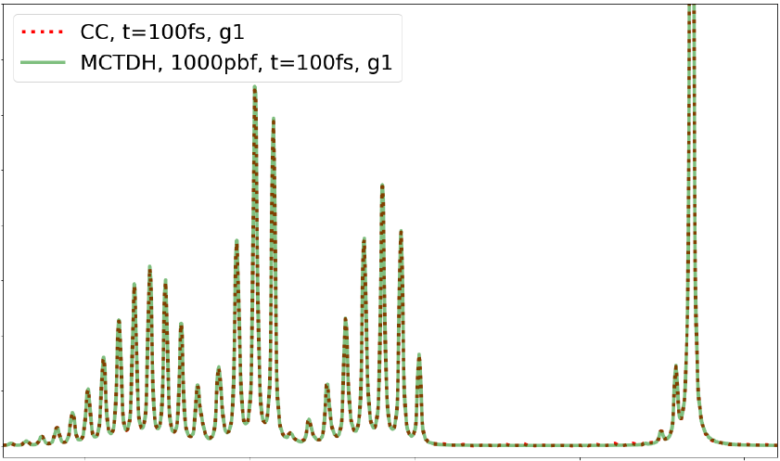
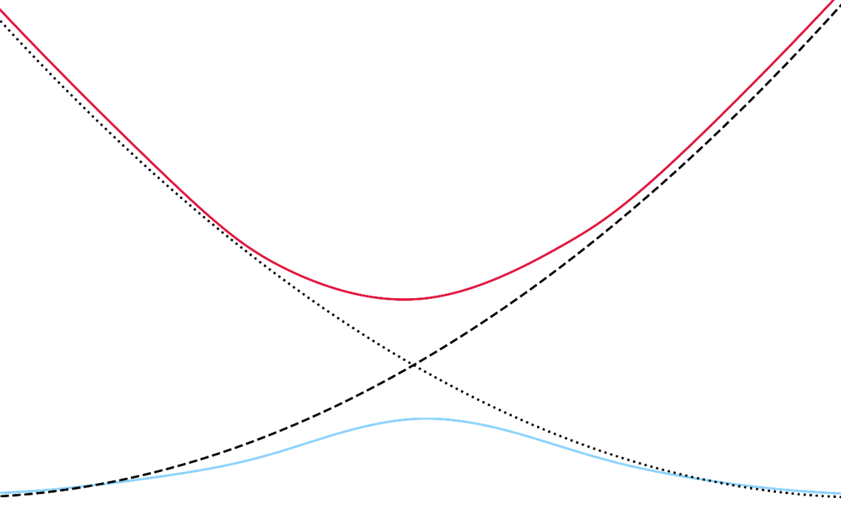
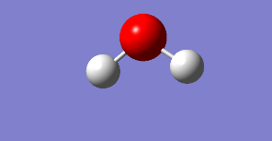
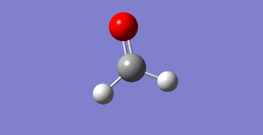
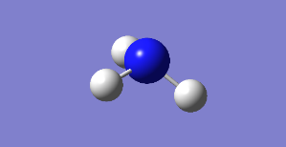
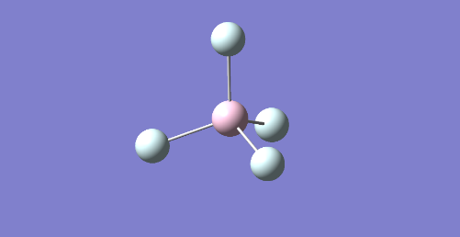
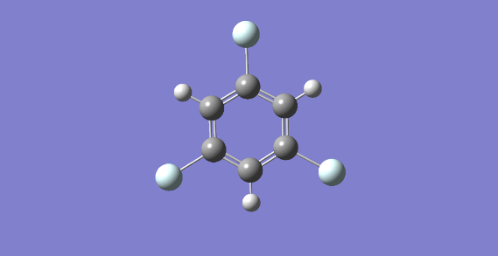
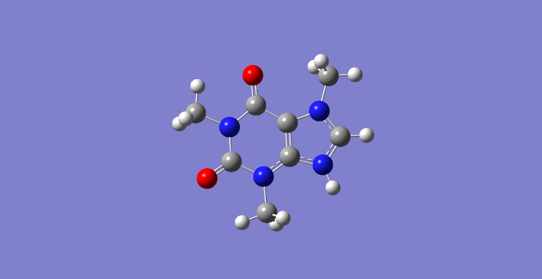
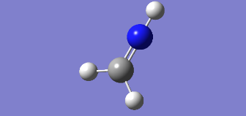
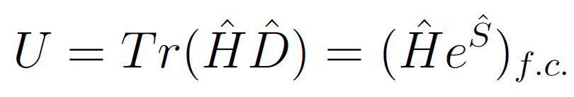
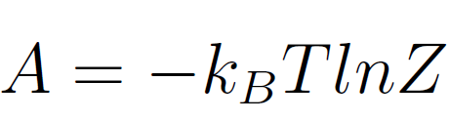
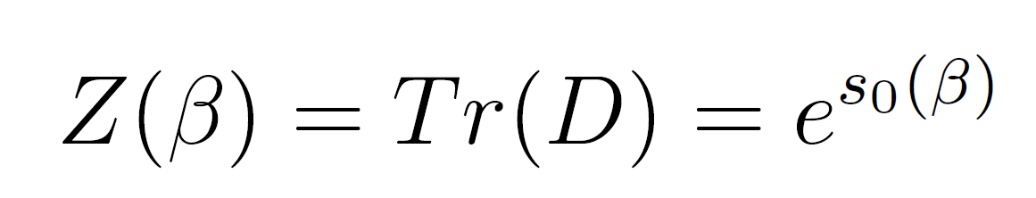
Exploration of vibronic model diabatization protocols and vibrational electronic coupled cluster (VECC) Approaches to statistical mechanics and spectroscopy
Diabatization
VECC
CHEM 794 Seminar Presentation
Benny Jun Chen

Slide 2

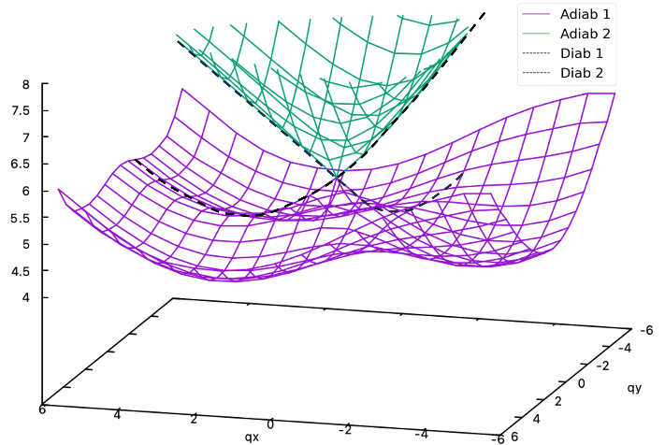
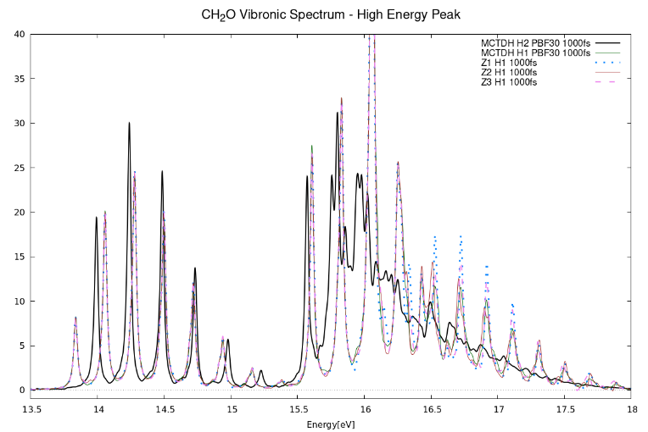





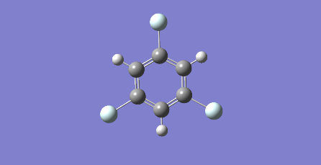





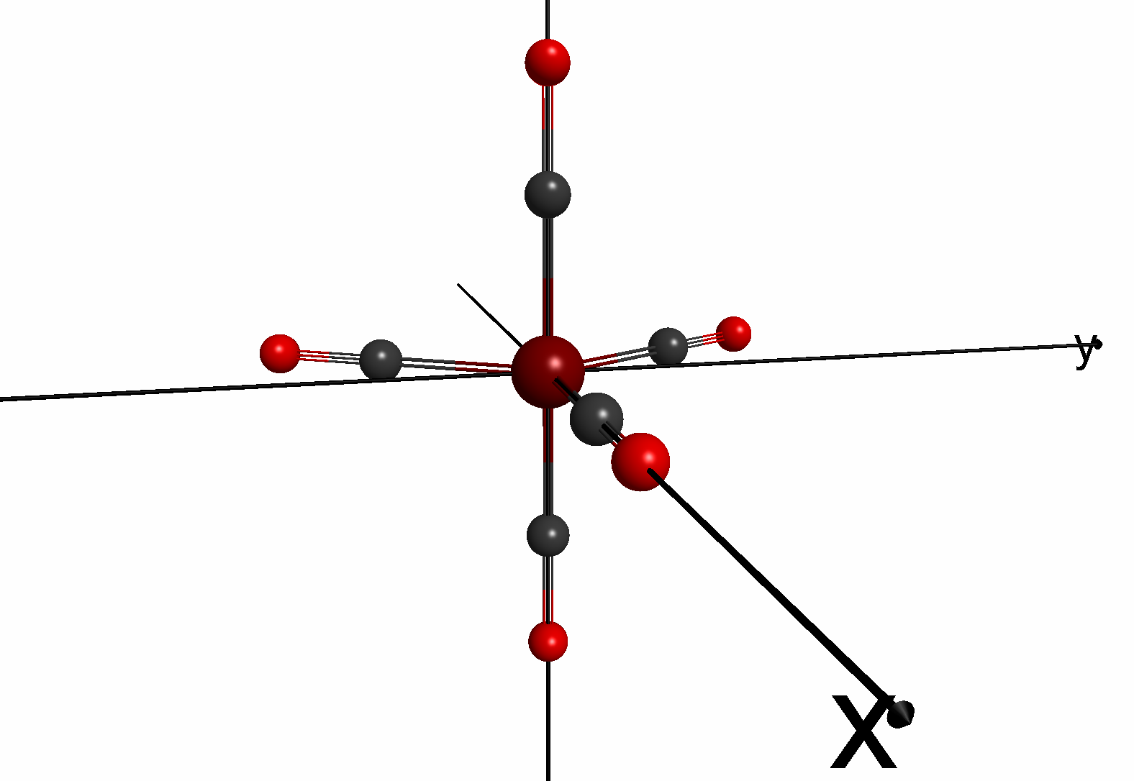
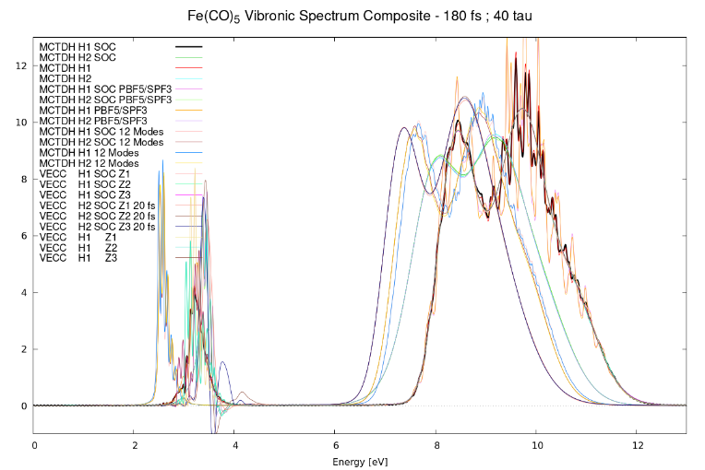
Santoro Protocol
X
Single reference
TD-DFT
Centerpiece
MCTDH
Vibronic
Spectra
Input
System
Zeng Protocol
Vibronic Model
VECC
Vibronic
Spectra
+ SOC!
✓
GAMESS
Multireference
GMC-QDPT
SOC
Notes:
Declarative statement: my work is here, other work is linked to it^.

Slide 3
Santoro Protocol
X
Single reference
TD-DFT
Centerpiece
MCTDH
Vibronic
Spectra
Input
System
Zeng Protocol
Vibronic Model
VECC
Vibronic
Spectra
+ SOC!
✓
GAMESS
Multireference
GMC-QDPT
SOC
Notes:
Declarative statement: my work is here, other work is linked to it^.

Slide 4
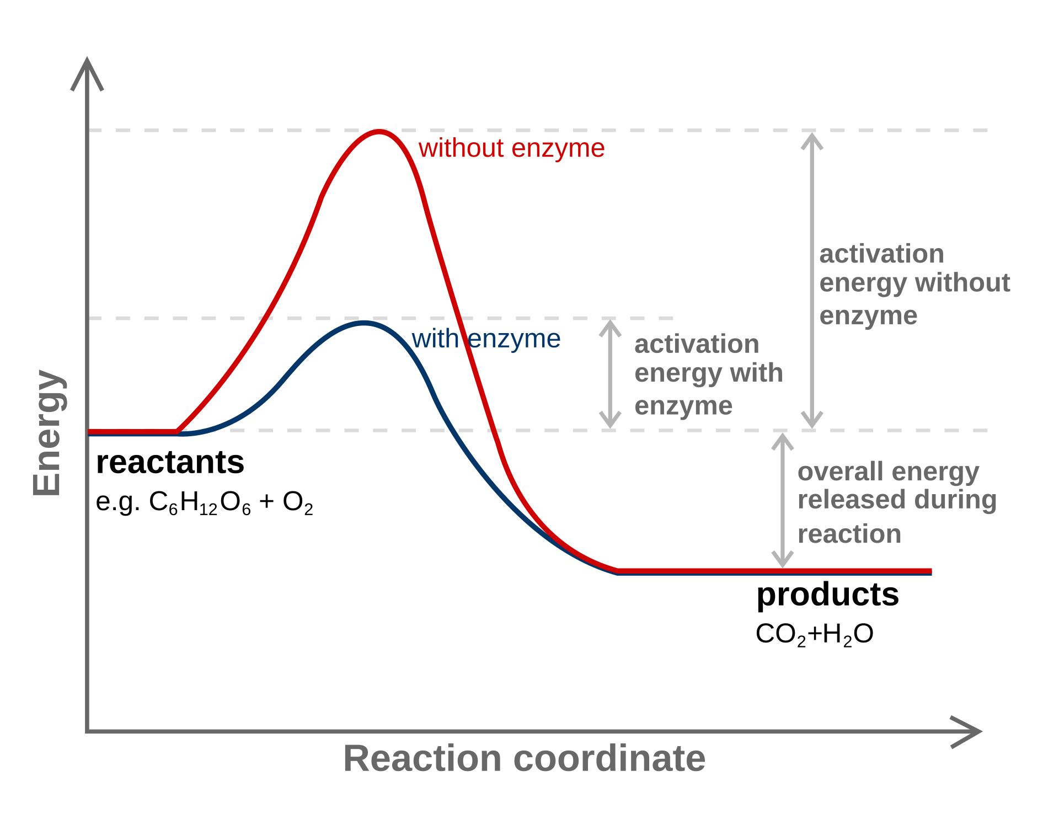
Input
System
Vibronic Model
Vibronic
Spectra
+ SOC!
Notes:
Declarative statement: my work is here, other work is linked to it^.

Slide 5

Fe(CO)₅ – CAS(10e,8o) Active Space
Zeng Protocol
Virtual Orbitals
50, 51 – e’
49 – e’’
47, 48 – e’
Active Space
45, 46 – e’’
44 – a₁
Frozen Orbitals

Slide 6
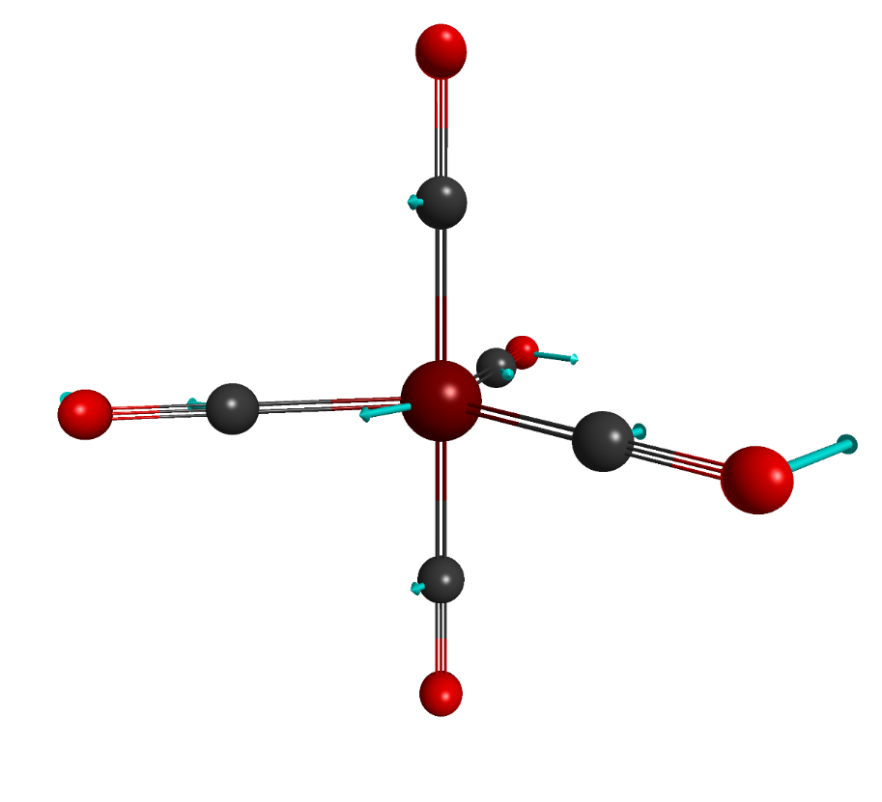
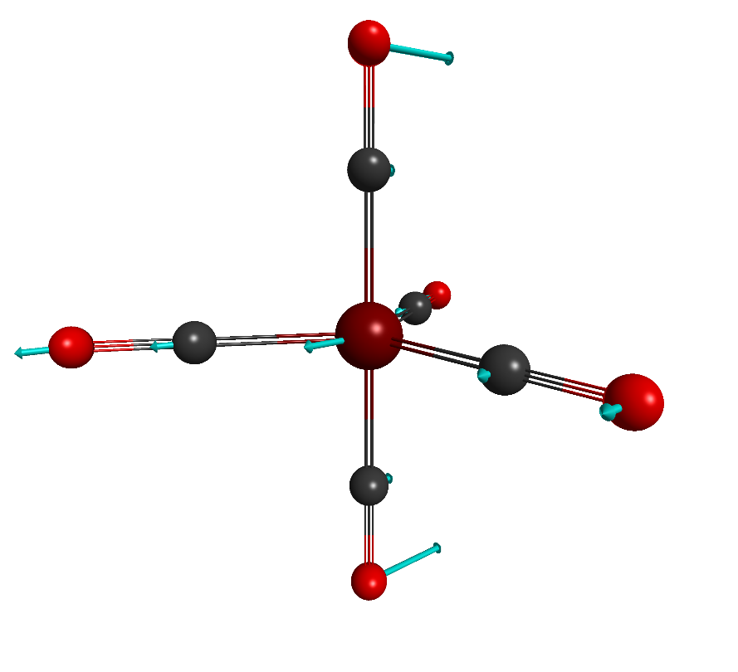
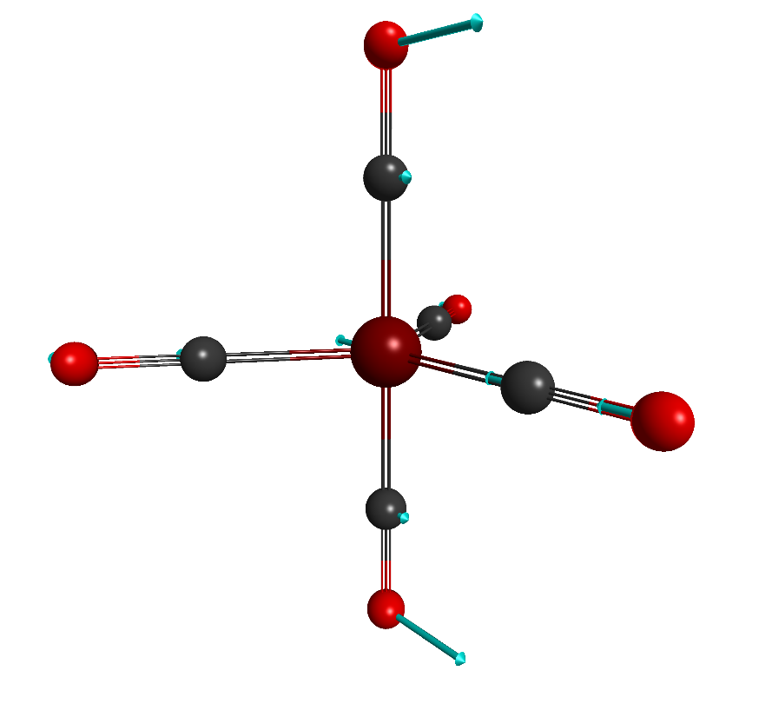
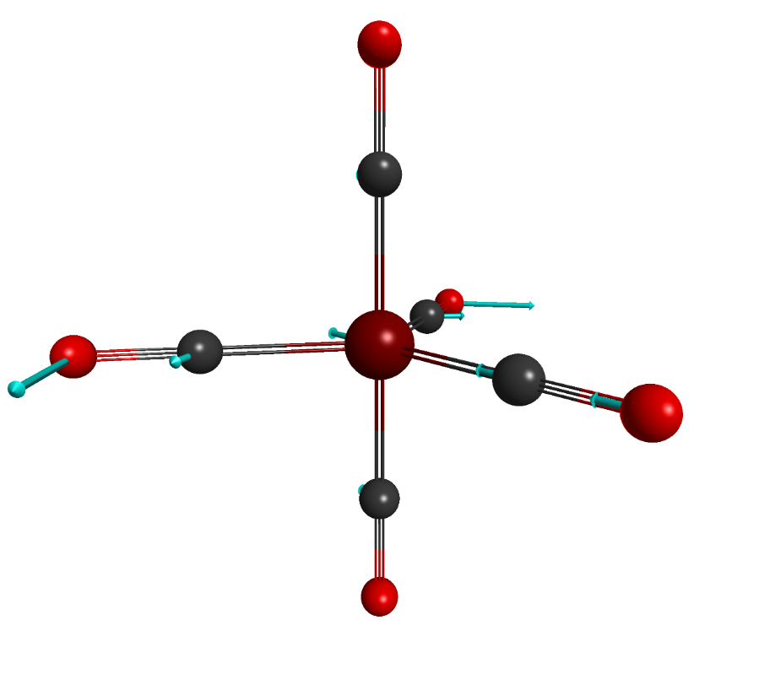
7 (E’) – 87.20 cm⁻¹
8 (E’) – 87.20 cm⁻¹
12 (E’) – 148.09 cm⁻¹
13 (E’) – 148.10 cm⁻¹
Notes:
M always increases or decreases by 1 under ladder operators acting.

Slide 7
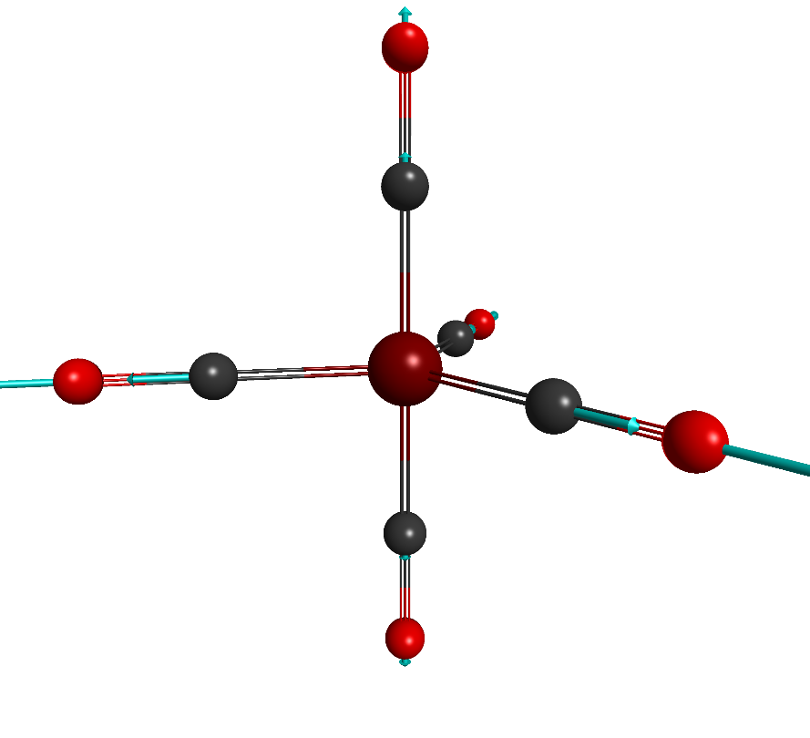
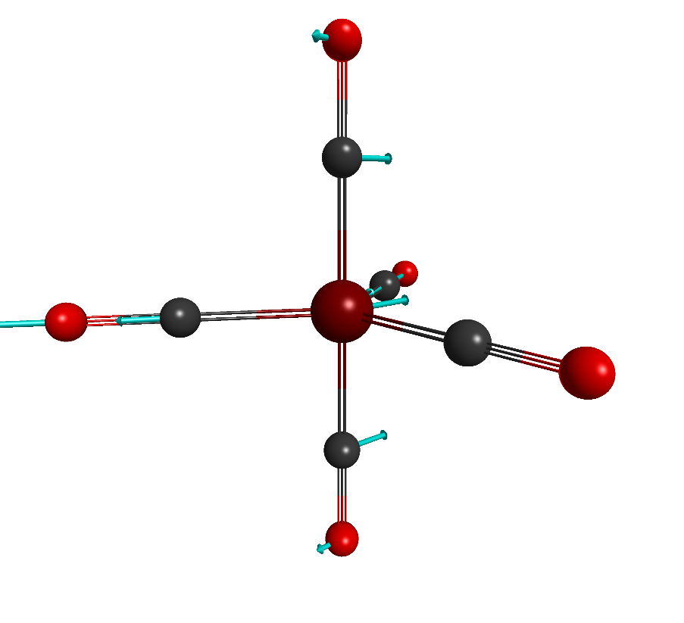
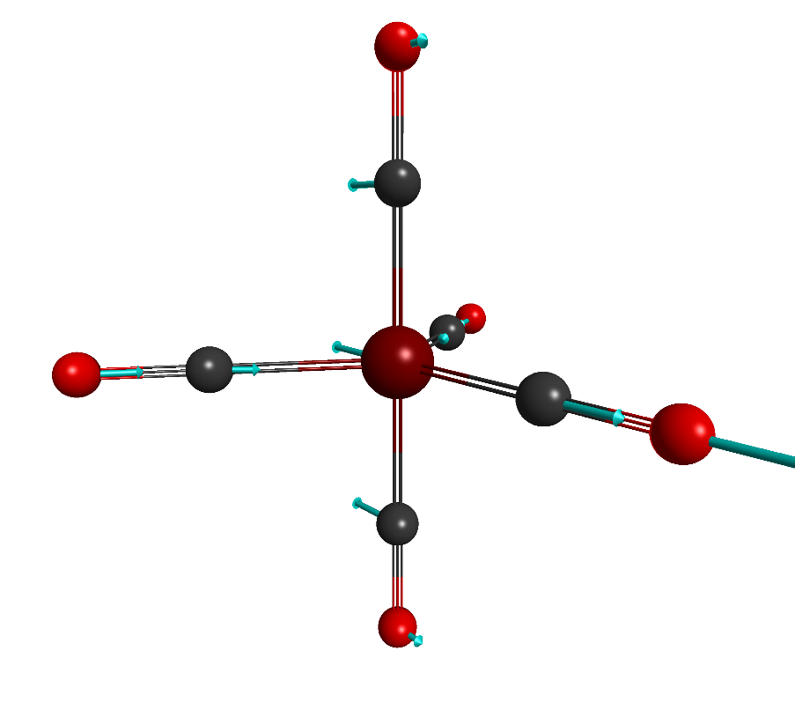
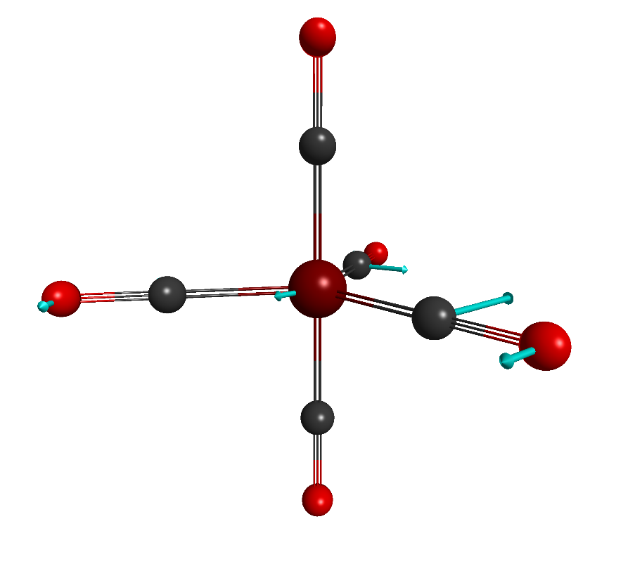
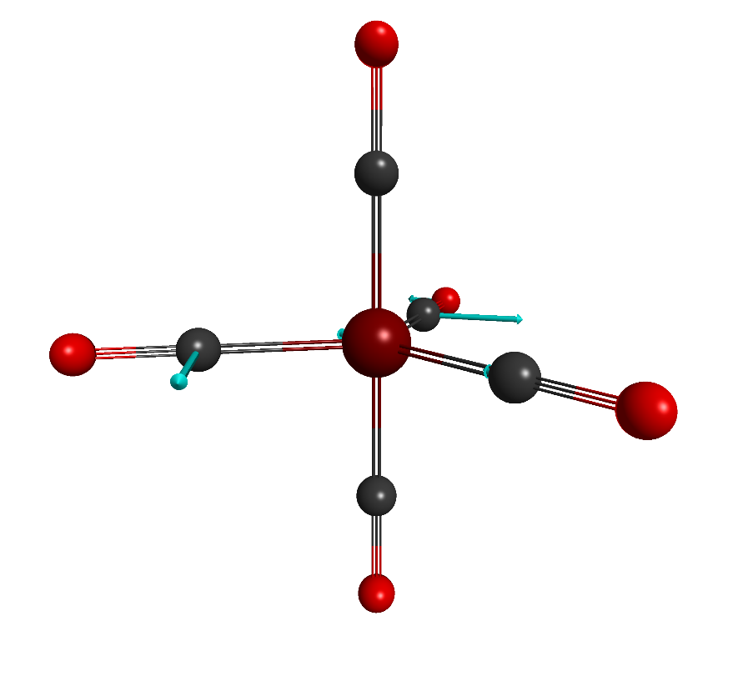
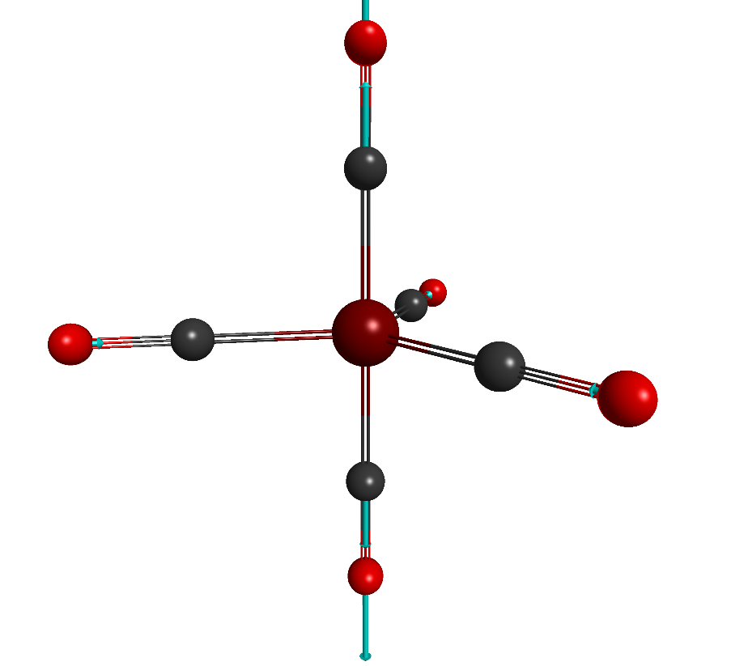
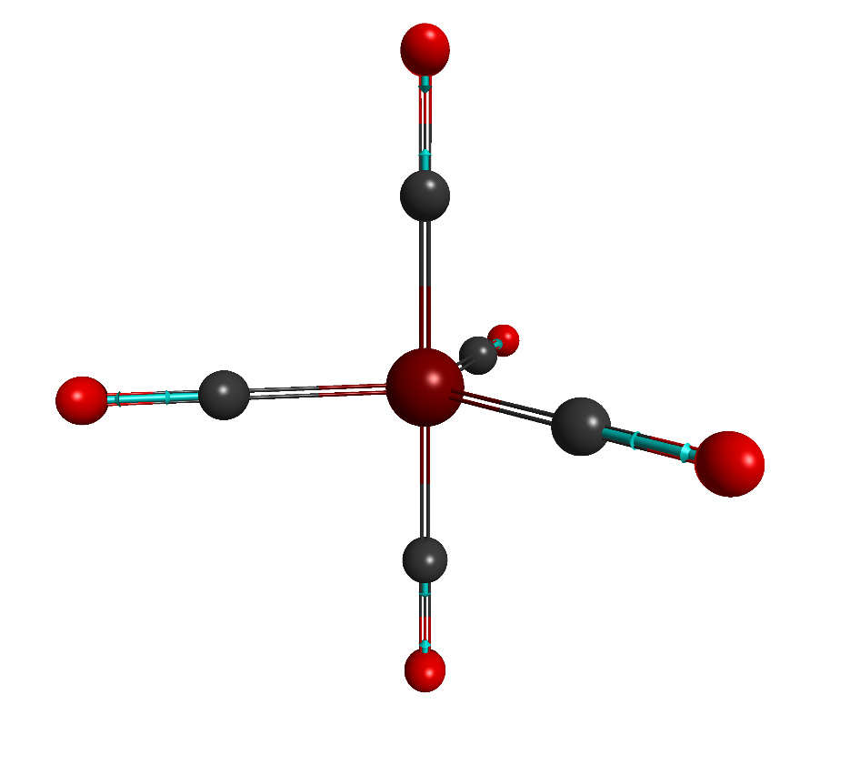

15 (A₁’) – 508.91 cm⁻¹
18 (E’) – 577.61 cm⁻¹
19 (E’) – 577.61 cm⁻¹
21 (E’) – 607.89 cm⁻¹
22 (E’) – 607.89 cm⁻¹
23 (A₁’) – 649.96 cm⁻¹
30 (A₁’) – 2055.77 cm⁻¹
31 (A₁’) – 2099.41 cm⁻¹
Notes:
M always increases or decreases by 1 under ladder operators acting.

Slide 8
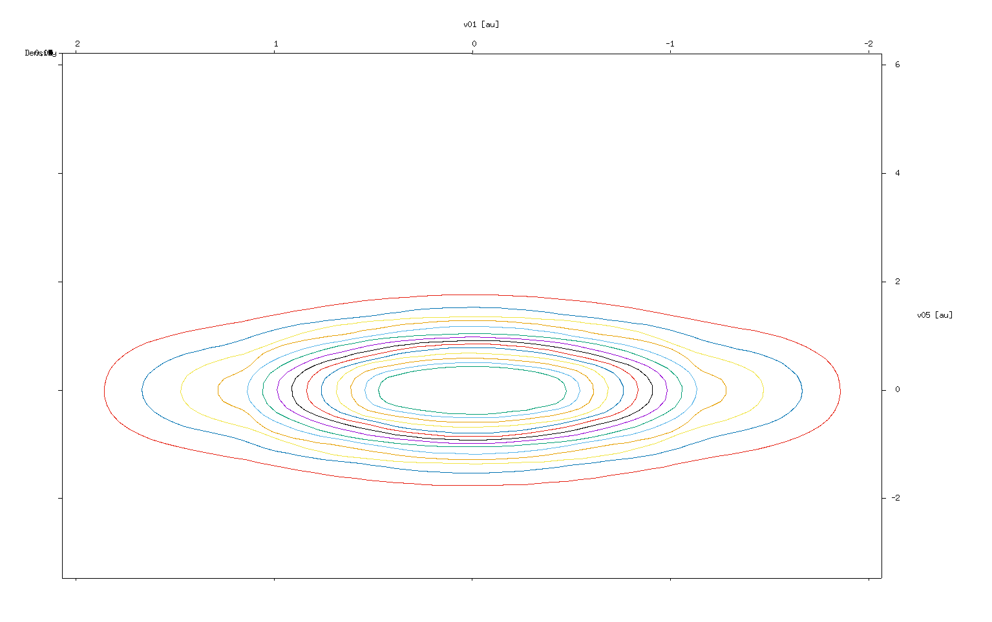
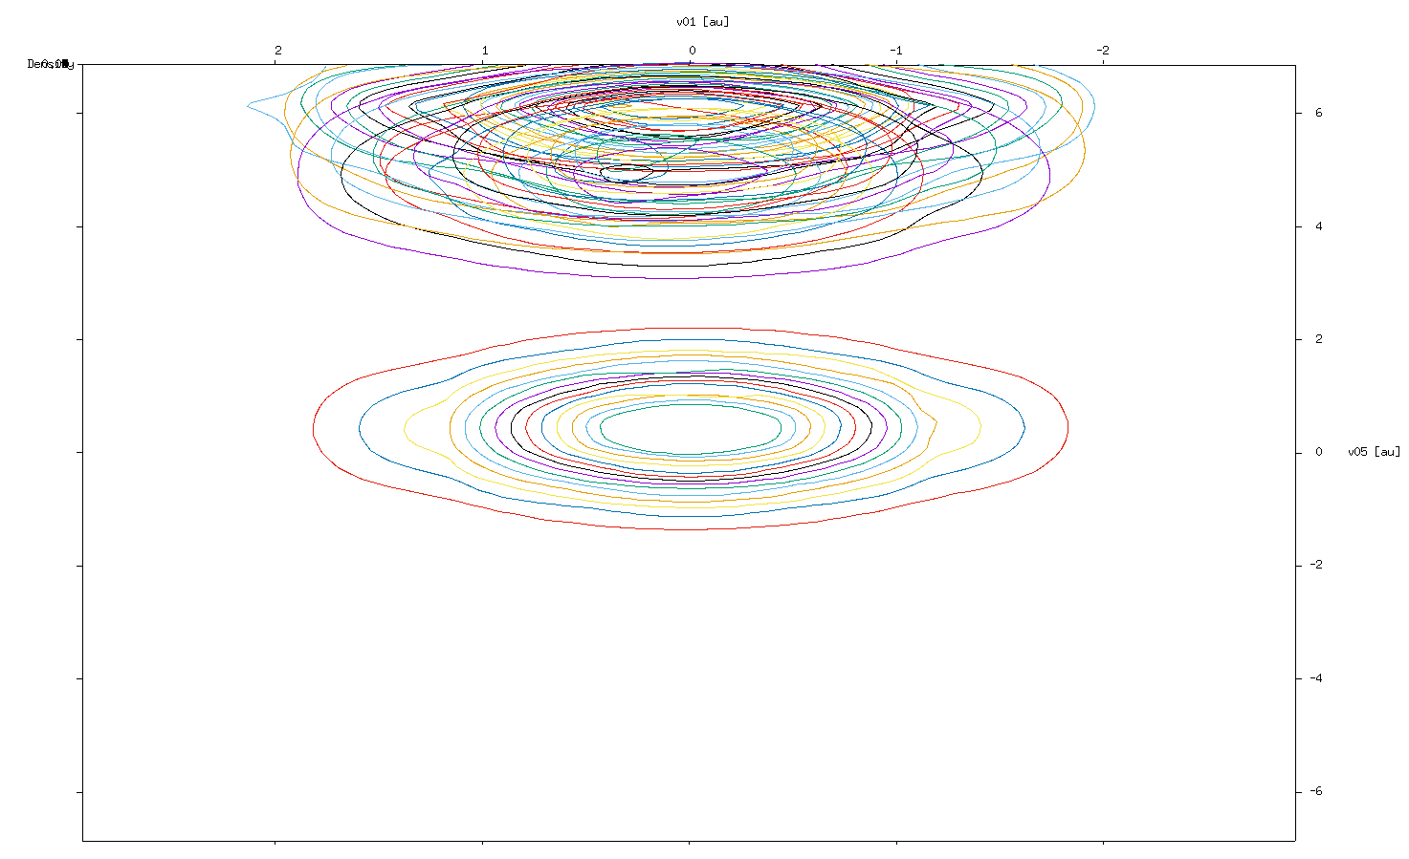
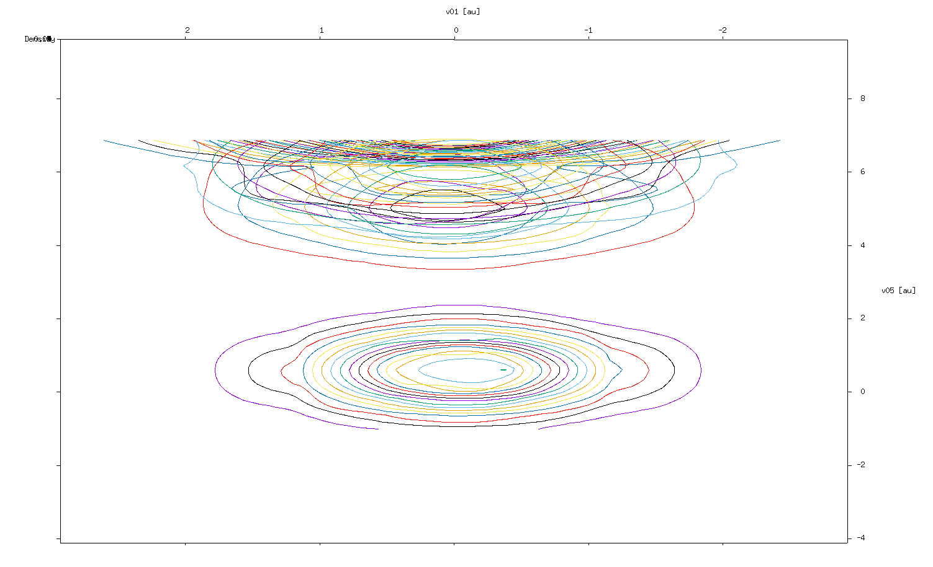
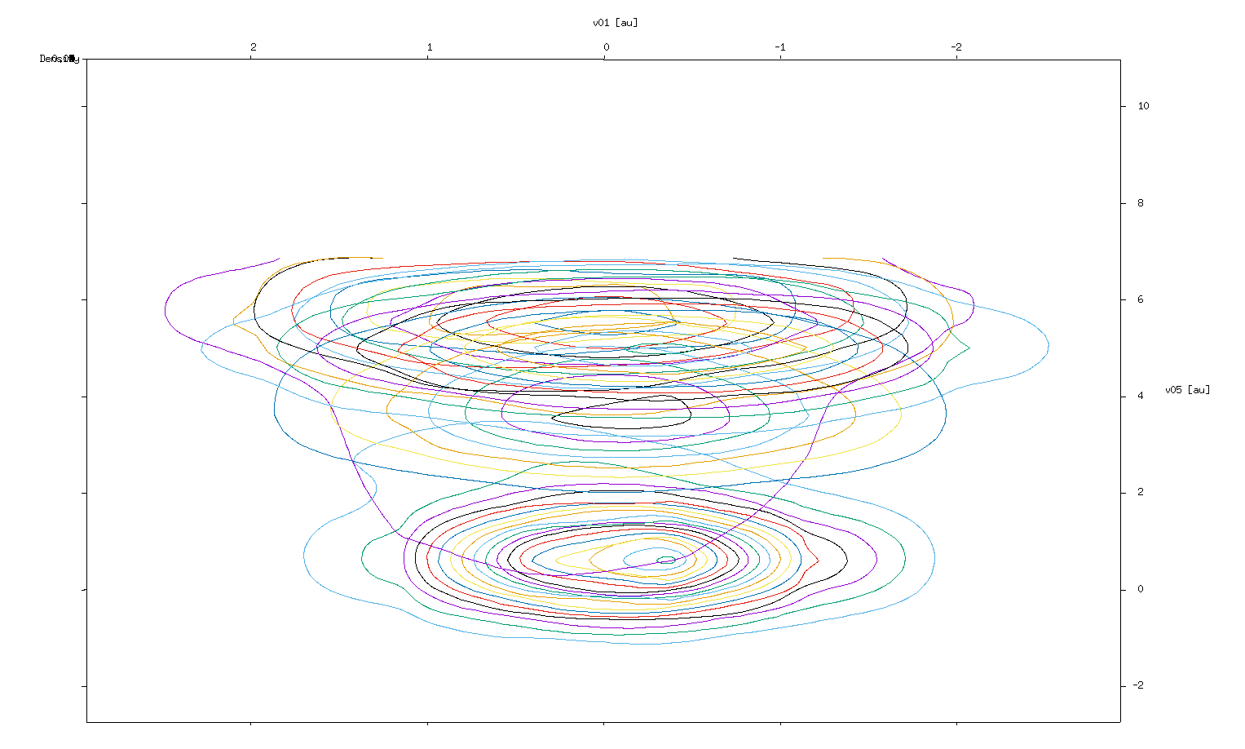
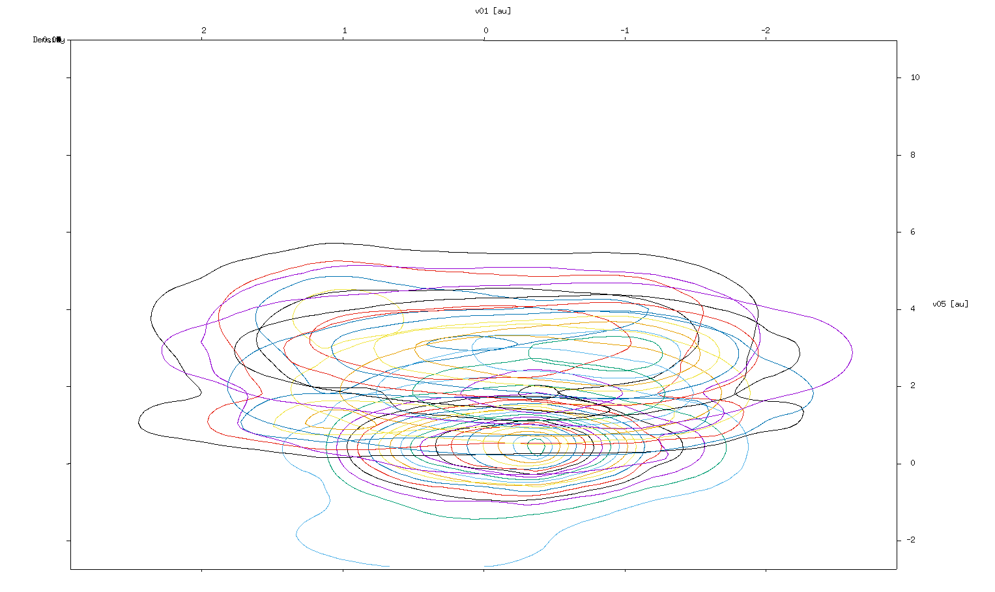
0 fs
23 fs
30 fs
40 fs
50 fs
Notes:
M always increases or decreases by 1 under ladder operators acting.

Slide 9
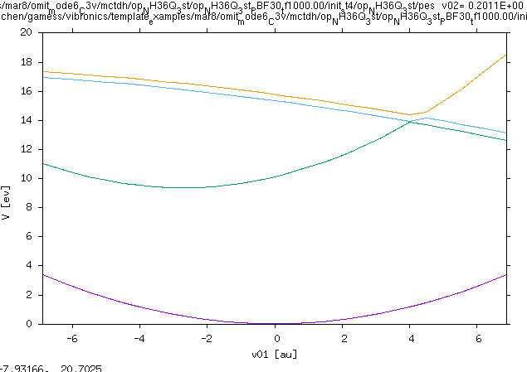
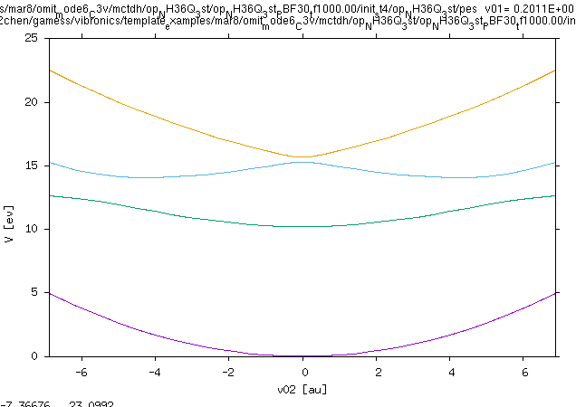
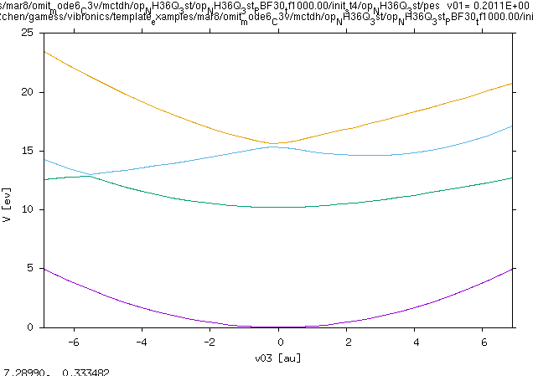
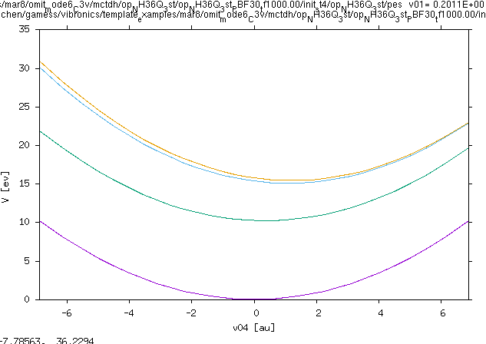
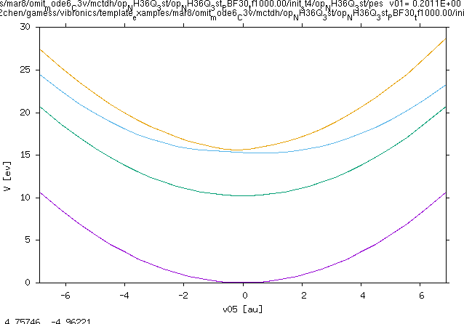
C_{3V} NH3 omit v06 – Adiabatic PES
NH3 – v01
NH3 – v02
NH3 – v03
NH3 – v05
NH3 – v05
Notes:
M always increases or decreases by 1 under ladder operators acting.

Slide 10
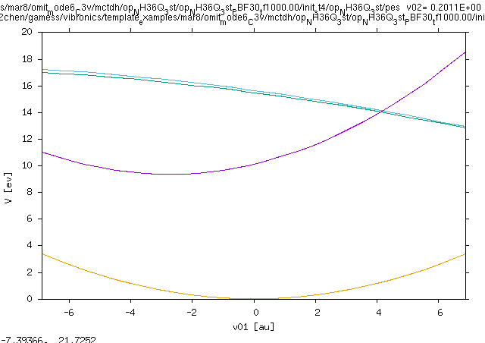
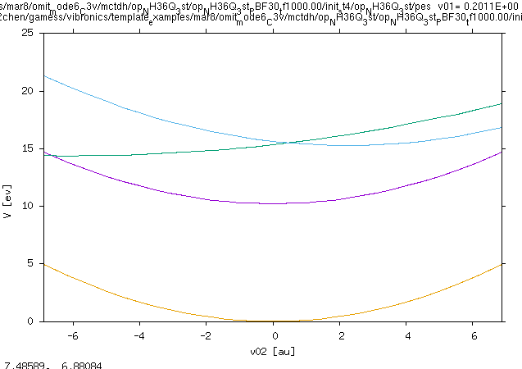
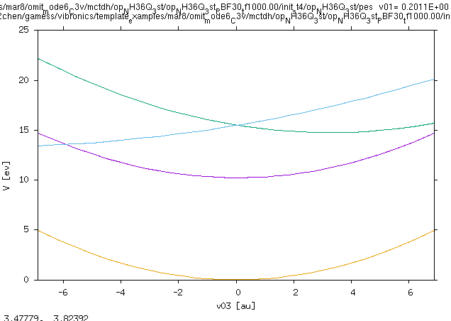
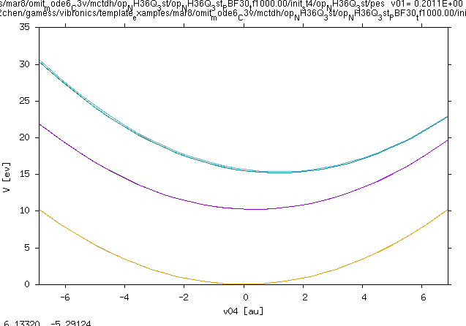
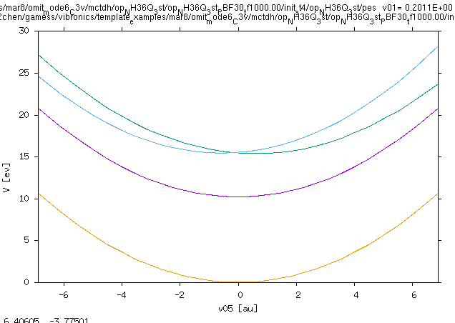
C_{3V} NH3 omit v06 – Diabatic PES
NH3 – v01
NH3 – v02
NH3 – v03
NH3 – v05
NH3 – v05
Notes:
M always increases or decreases by 1 under ladder operators acting.

Slide 11
RhF₃ – CAS(6e,5o) Active Space
Virtual Orbitals
Rh: [Kr] 4d⁸ 5s¹
F₃: [He] 2p⁵ 2s²
Active Space
12 doubly occupied, 5 active
Frozen Orbitals
21 frozen core orbitals

Slide 12
SOC CHANGES EVERYTHING!
Concerted effort to figure it all out…
Notes:
Claire

Slide 13


Slide 14
Introduction
Development of quantum chemistry has seen important progress
Calculations studying chemical systems are often intractable
Apply approximations and novel approaches to tackle problems
Project goal: investigate vibronic model protocols, a success here is to apply and master them for spectroscopy and thermal properties
Notes:
Beyond Hartree-Fock: ongoing advances in dynamical electron correlation, non-adiabatic dynamics.

Slide 15
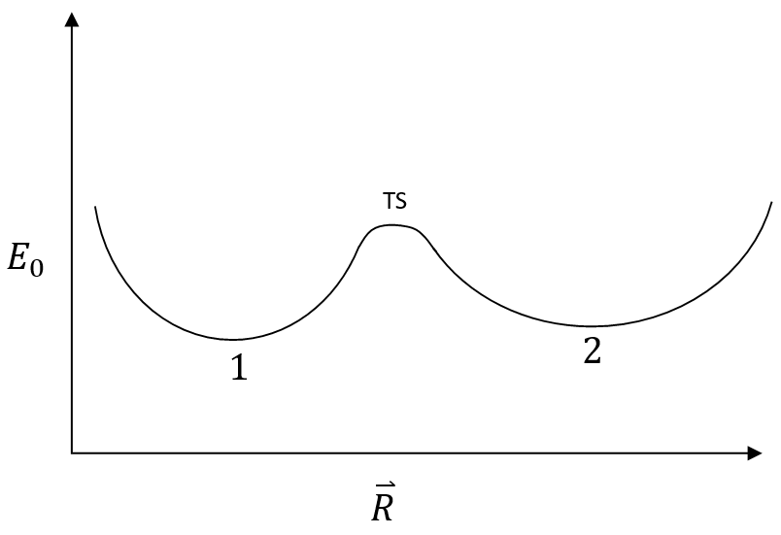
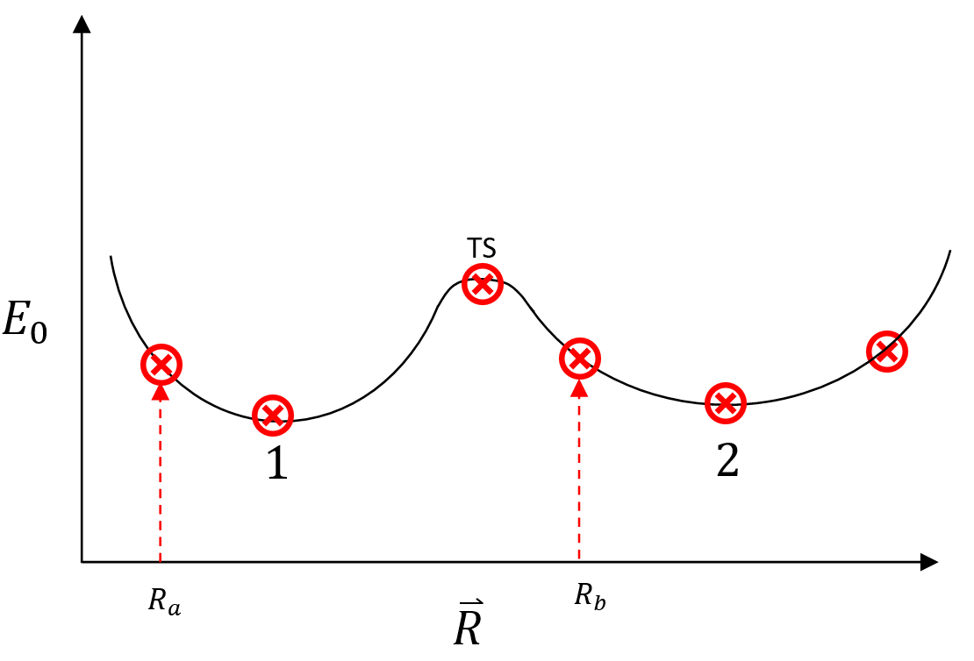
Electronic Structure Theory
Approximations can fail
Born-Oppenheimer Approximation (BOA)
fixed nuclear configurations (R_{a}, R_{b}, ….)
Construct ground state potential energy surface
Stereotypical depiction of a BOA electronic ground state surface
Notes:
Claire

Slide 16
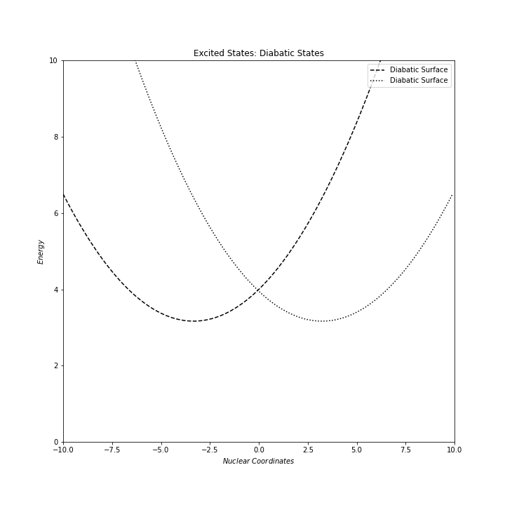
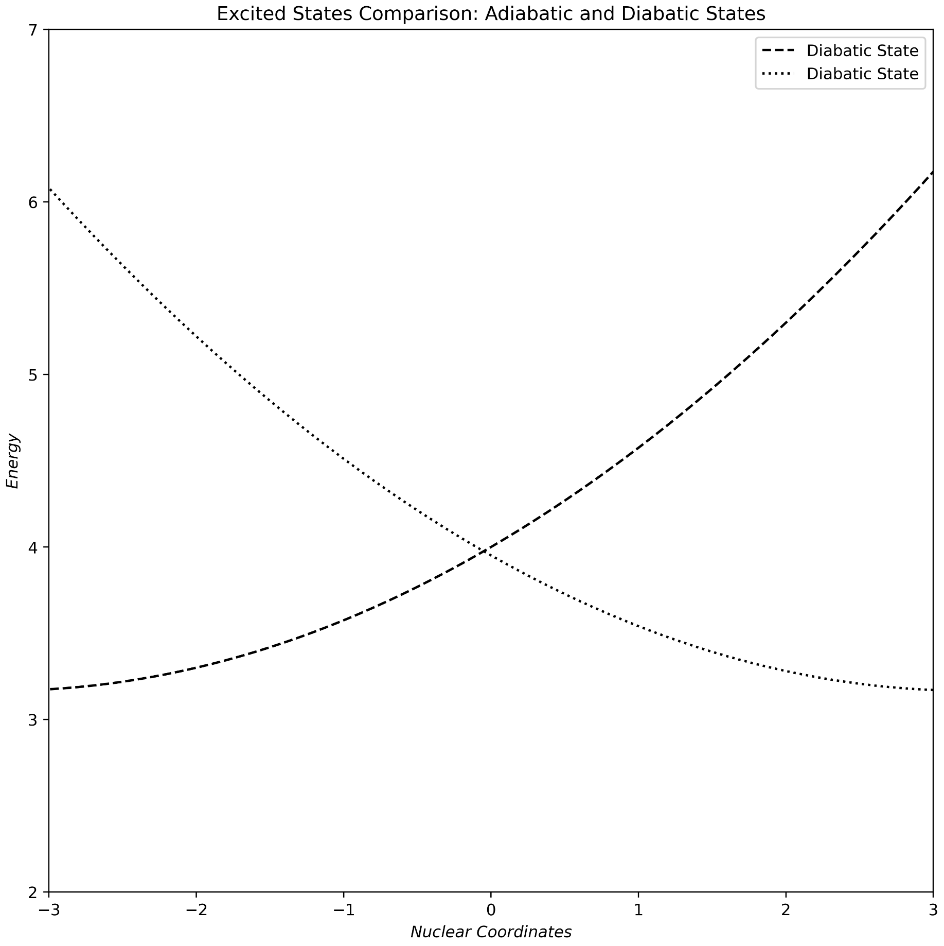
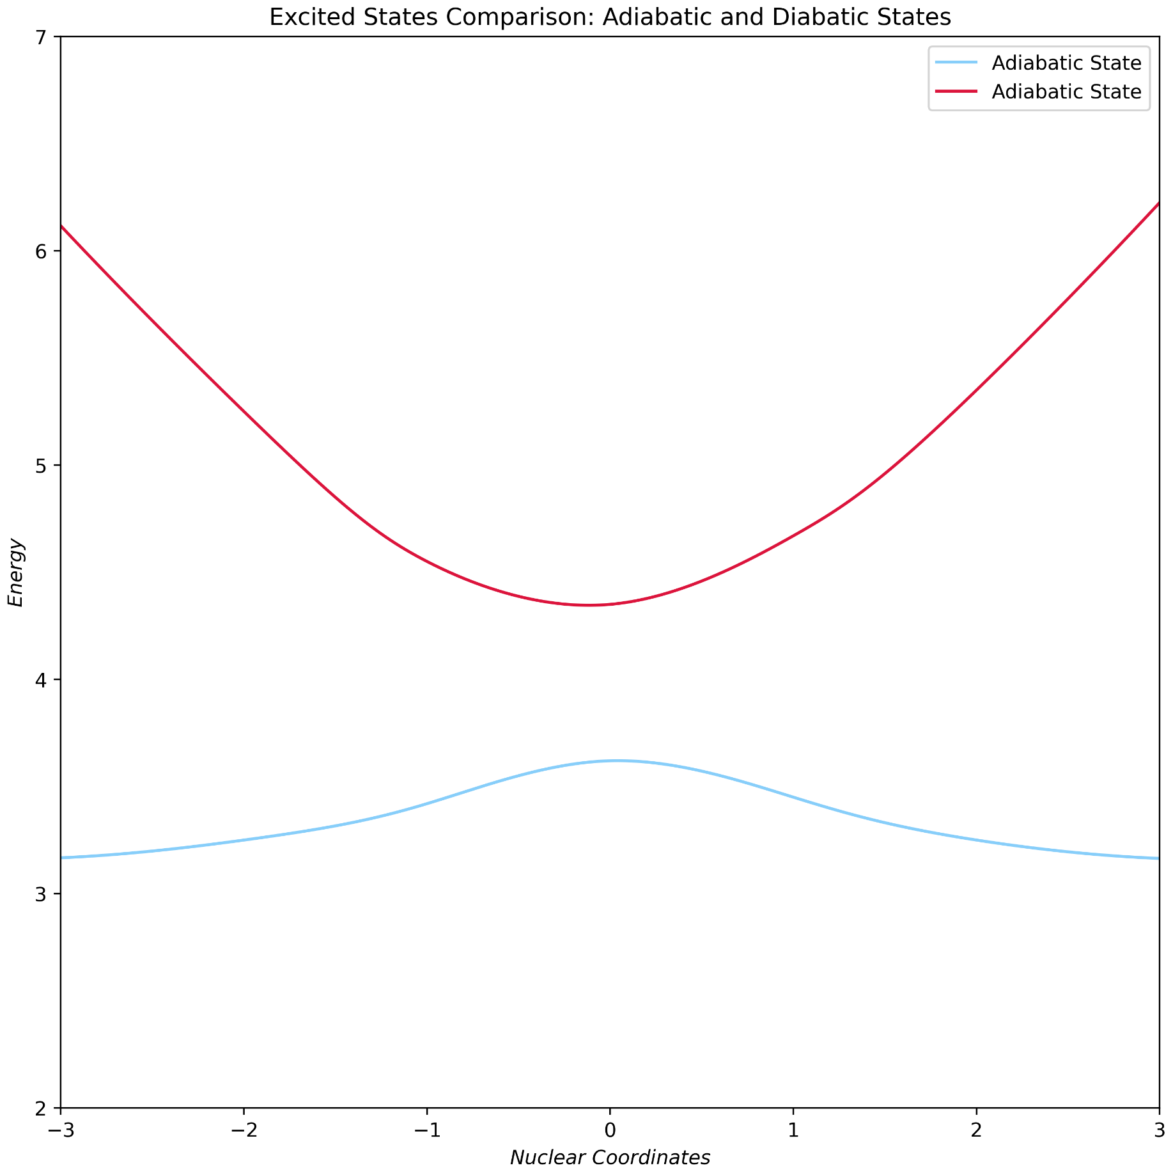
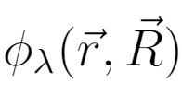

Excited States
Diabatic states → approximated by simple harmonic potentials
Adiabatic states → true BOA surfaces, complicated to represent
Near degenerate states, Hamiltonian contains additional non-adiabatic coupling terms (N.A.C.)
Electronic wavefunction changes rapidly.
ΔE ~0.1 eV
Notes:
Claire

Slide 17




Electronic Structure Theory
Molecular Schrödinger’s Equation (S.E.):
Full expansion of molecular Hamiltonian acting on the wavefunction
nuclear configuration
electron coordinates
Notes:
There is a single En value for each n. Focus is on the presence of an integral in terms A and C.

Slide 18




Beyond The Born-Oppenheimer Approximation
Both A and C contain integrals
Evaluating integrals is expensive
A and C (N.A.C.) terms cannot be ignored when states are degenerate
Eμ
ΔE
Eλ
Notes:
A corresponds to diagonal correction in BOA. C is derivative coupling; off-diagonal N.A.C.
Size is inversely proportional to energy separation.

Slide 19


Beyond The Born-Oppenheimer Approximation
Must change from adiabatic states (BOA) by invoking diabatic states
Diabatic states: characterized by changing as little as possible w.r.t. geometry
If does not change much:
Proceed to neglect N.A.C.
Notes:
We also ignore A, but that is implied.

Slide 20








Adiabatic States Diabatic States
Diabatization (H.O. like):
Cost: is a potential matrix.
Notes:
No free lunch!!

Slide 21



Vibronic Coupling Models
Describes the interaction between vibrational and electronic (vib-ronic) energy levels
Models systems governed by multiple electronic potential energy surfaces
Obtain matrix describing potential and coupled set of diabatic wavefunctions :
Goal: parametrize and calculate matrix for limited set of electronic states
Notes:
Ongoing research in this area of chemistry. Obtain matrix and diabatic wavefunctions.
For my purposes, focus on how vibronic theory can describe the interaction because that’s what your interested

Slide 22
Research OUTLINE
Notes:
Tiara

Slide 23
Outline – Specific Work in Perspective
Investigate sophisticated diabatization protocols
Identify optimal vibronic model parameters, benchmark studies
Gain proficiency with running routine calculations (not trivial)
Tackle additional chemical systems for vibronic model input
Compute new models of interest, perhaps collaborate with Hopkins group
Obtain spectroscopy and statistical mechanical properties
Further improve and facilitate computational workflow
Notes:
Highlight what the advantages of the scripts are, and that motivates why improving them is good.
Something like “using the scripts saved me hundreds of hours compared to manually preforming every single minute task involved in the computation process”
“Therefore improving and maintaining this scripts is a worthwhile goal, not just for myself, but also for future students/researches so that it may help them as well”

Slide 24
Research Context in a Nutshell
Diabatization
Scheme
Theoretical Q.M.
Computations
Input
System
Properties of Interest
Notes:
Declarative statement: my work is here, other work is linked to it^.

Slide 25

Research Context in a Nutshell
Santoro Protocol
MCTDH
Input
System
Vibronic
Spectra
Vibronic Model
VECC
Nooijen Lab
Nooijen Lab
Previous work
Motivation
Notes:
Declarative statement: my work is here, other work is linked to it^.

Slide 26



MCTDH
Non-adiabatic Dynamics: MCTDH Approach Characteristics
Multi-configurational Time Dependent Hartree (MCTDH) is an approach for non-adiabatic dynamics simulations
Conventional gold standard in quantum chemistry, used for 3 decades
MCTDH is a very accurate technique that converges onto non-relativistic S.E. solution
Can take in vibronic model input, propagate wave packet on E.S. surface using quantum dynamics
Fourier Transform

Slide 27


MCTDH Drawbacks
MCTDH
Extremely user unfriendly, a lot of complicated user input is required
Utilizing multi-layer (ML-MCTDH) technique is encouraged for optimal results
Computationally uneconomical, explosive exponential scaling
Only feasible for small systems
Typical mood
Using MCTDH
Navigate: Explore possible alternative approaches
VECC is being developed, new formulations
(Not part of project, but awareness is needed)

Slide 28



VECC
VECC Approach Characteristics
Vibrational Electronic Coupled Cluster (VECC) is Nooijen group’s novel approach for spectra
and statistical mechanics based on vibronic models (both are still in progress)
My discussion focuses on single surfaces, keeps it simpler
Developed by PhD students Neil and Songhao
VECC software package will be published on GitHub
Propagates a coupled-cluster (CC) wavefunction (mixed CC/CI ansatz) in modified projection manifold equation of motion
Time-dependent Schrödinger Equation
Ansatz and cluster operator
Equation of motion
[a] M. Nooijen and S. Bao, “Normal ordered exponential approach to thermal properties … examples” , Molecular Physics 119, (2021).

Slide 29


VECC Approach to Spectroscopy (single surface)
VECC
VECC likewise parameterizes time-dependent wavefunction using NOE
H.O. excited state Hamiltonian expressed in normal order with second-quantized operators:
CC time-autocorrelation function:
[a] M. Nooijen and S. Bao, “Normal ordered exponential approach to thermal properties and time-correlation functions: general theory and simple examples” , Molecular Physics 119, (2021).

Slide 30

VECC Spectrum
VECC
Photoelectron Spectrum of Formaldehyde
[b] M. Nooijen and S. Bao, “Normal ordered exponential approach to thermal properties and time-correlation functions: general theory and simple examples” , Molecular Physics 119, (2021).
Notes:
Do comparison with full vibronic spectrum, ask Songhao.

Slide 31

Research Context in a Nutshell
Santoro Protocol
MCTDH
Input
System
Vibronic
Spectra
Vibronic Model
VECC
Nooijen Lab
Statmech
too!
PhD: Neil and Songhao
Notes:
Declarative statement: my work is here, other work is linked to it^.

Slide 32


VECC
VECC Approach to Statistical Mechanics
VECC solves statmech by a normal ordering exponential (NOE) alternative operator technique
Allows for calculation of thermal density matrices
Determine properties: partition function (Z) internal energy, etc
Benchmark via comparison with (very costly but accurate) ‘Sum over States’ formulation
[a] M. Nooijen and S. Bao, “Normal ordered exponential approach to thermal properties and time-correlation functions: general theory and simple examples” , Molecular Physics 119, (2021).
Notes:
I am simply giving this background, I would like to understand this better in my masters. Put brackets around H{e^S}.

Slide 33

VECC Thermal Properties (test for single surface H.O.)
VECC
Partition Function Results Comparison of VECC-NOE and SOS Approaches
[a] M. Nooijen and S. Bao, “Normal ordered exponential approach to thermal properties and time-correlation functions: general theory and simple examples” , Molecular Physics 119, (2021).

Slide 34
VECC Approach Advantages over MCTDH
VECC
User-friendly, demands very little user choices, limited to on/off switches
Although less systematic than MCTDH’s comprehensiveness
Avoids exponential scaling and enjoys polynomial time
Example: Ethylene (C₂H₄), 3N-6 = 12 normal modes
– MCTDH: 30¹² coefficients
- VECC: 1125 time-dependent coefficients
✓
Non-negotiable: Both require vibronic models as input, who supplies vibronic models?

Slide 35
Vibronic models
Diabatization Protocols
Notes:
Claire

Slide 36
Research Context – Diabatization Protocols
Santoro Protocol
MCTDH
Input
System
Vibronic
Spectra
Vibronic Model
VECC
Nooijen Lab
Statmech
too!
Notes:
Declarative statement: my work is here, other work is linked to it^.

Slide 37




Follow Dr. Fabrizio Santoro’s (Gaussian-MCTDH) Protocol
Santoro Protocol
Dr. Fabrizio Santoro of Italian National Research Council has formulated a new sophisticated protocol for vibronic models, advancing a linear vibronic coupling model using TD-DFT
Adiabatic States (BOA) Diabatic States
J. Chem. Theory Comput. 2020, 16, 9, 5792–5808
Notes:
Benny

Slide 38

Hexahelicene (C₂₆H₁₆) Spectrum
Santoro Protocol
Notes:
Say we are missing the low energy region, clearly we do not agree here to large degree we are in ballpark, lots of knobs to turn. We missed low energy peak.

Slide 39

Caffeine
Santoro Protocol
Caffeine from Lynne Murdoch (Hopkins Lab 494)
Notes:
Say we are missing the low energy region, clearly we do not agree here to large degree we are in ballpark, lots of knobs to turn. We missed low energy peak.

Slide 40




Limitations to Santoro G-MCTDH Protocol
Santoro Protocol
Vibronic model only provides linear coupling terms
TD-DFT is single reference in nature
Transition metal spectra requires multireference calculations
Models not sufficient for VECC to calculate statistical mechanics properties
Protocol uses Gaussian 16 package
Tiara
Claire
TiCl₄
Notes:
Mention that nobody in Nooijen groupi can use Gaussian, all banned.

Slide 41


Software and Hardware Limitations
Santoro Protocol
Gaussian 16 software availability on ComputeCanada server
Nooijen group is banned by Gaussian!
Memory limitations also restrict computations on nlogn server
Parallelized computation for vibronic models often required
Takeaway: Pivot towards new diabatization scheme?
Notes:
Mention that nobody in Nooijen groupi can use Gaussian, all banned.

Slide 42

Vibronic Model Alternative Protocols
Santoro Protocol
MCTDH
Input
System
Vibronic
Spectra
Vibronic Model
Zeng Protocol
VECC
GAMESS (no Gaussian!)
Multireference
CASSCF
GMC-QDPT
Statmech
too!
Notes:
Declarative statement: my work is here, other work is linked to it^.

Slide 43
MCSCF Calculations
Zeng Protocol
Multiconfiguration Self-Consistent Field (MCSCF), a mix between CI and SCF:
A linear combination of multiple Configuration State Functions (lincomb of Slater determinants)
Optimizes both configuration mixing (CI) and molecular orbital expansion coefficients (SCF)
Multi-reference: study excitations using multiple-configurations
MCSCF manufactures the multi-reference wavefunctions for MRCI/MRCC excitations using multi-configurations
Appropriate for VECC approach

Slide 44
CASSCF Theory
Zeng Protocol
Complete Active Space SCF (CASSCF) is a special type of MCSCF
Recipe: dictate subset of active electrons (N) and orbitals (M) perform calculation in full CI manner
CASSCF(N,M)
Water (H₂O): CASSCF(8,6)
Have to employ empirical strategy to select active space
Typically full valence space is ideal
Virtual Orbitals
Active Space
Frozen Orbitals

Slide 45
Vibronic Model Alternative Protocols
Santoro Protocol
MCTDH
Input
System
Vibronic
Spectra
Vibronic Model
Zeng Protocol
VECC
GAMESS (no Gaussian!)
Multireference
CASSCF
GMC-QDPT
✓
Statmech
too!
✓
✓
Vibronic Models and VECC
Notes:
Declarative statement: my work is here, other work is linked to it^.

Slide 46


Vibronic Models
Single reference,
TD-DFT
Santoro Protocol
MCTDH
Input
System
Vibronic
Spectra
Vibronic Model
Zeng Protocol
VECC
SOC & Statmech
too!
✓
Multi-reference,
GMC-QDPT
Notes:
Declarative statement: my work is here, other work is linked to it^.

Slide 47
Vibronic Models
Single reference,
TD-DFT
Santoro Protocol
MCTDH
Input
System
Vibronic
Spectra
Vibronic Model
Zeng Protocol
VECC
SOC & Statmech
too!
✓
Multi-reference,
GMC-QDPT
Notes:
Declarative statement: my work is here, other work is linked to it^.

Slide 48
Santoro Protocol
X
Single reference
TD-DFT
MCTDH
Vibronic
Spectra
Input
System
Zeng Protocol
Vibronic Model
VECC
Vibronic
Spectra
+ SOC!
✓
GAMESS
Multireference
GMC-QDPT
SOC
Notes:
Declarative statement: my work is here, other work is linked to it^.

Slide 49
MCTDH
Vibronic
Spectra
Input
System
Zeng Protocol
Vibronic Model
VECC
Vibronic
Spectra
+ SOC!
GAMESS
Multireference
GMC-QDPT
SOC
Notes:
Declarative statement: my work is here, other work is linked to it^.

Slide 50
RhF₃ – CAS(6e,5o) Active Space
Virtual Orbitals
Rh: [Kr] 4d⁸ 5s¹
F₃: [He] 2p⁵ 2s²
Active Space
12 doubly occupied, 5 active
Frozen Orbitals
21 frozen core orbitals

Slide 51

GMC-QDPT Method
Zeng Protocol
General Multiconfiguration-Quasidegenerate Perturbation Theory: ‘diagonalize-then-perturb-then-diagonalize’
Zeng’s protocol uses GMC-QDPT in a model space diabatization scheme
Dependent on CASSCF
Highlights: nmo flags

Slide 52





Zeng Diabatization Protocol
Zeng Protocol
Description | GAMESS Output
Converge on G.S. optimized molecular geometry. Obtain RHF orbitals. MP2/ cc-pVTZ
Description | GAMESS Output
Molecular system to be studied. For GAMESS, have to know point group!
Description | GAMESS Output
GMC-QDPT calculation for semi-canonical orbitals to be used as diabatic MOs. CH₂NH: CASSCF(14,11)
Virtual Orbitals
Active Space
*H₂O cartoon
for simplicity
Frozen Orbitals

Slide 53






Zeng Diabatization Protocol
Zeng Protocol
Description | GAMESS Output
Generate adiabatic states and reference determinants.
Description | GAMESS Output
Generate the diabatic states and compose unitary transform matrix.
Description | GAMESS Output
Vibronic model information currently V_{ab}(R_{e} + Δq), further processing needed for submission to MCTDH/VECC.
MCTDH
VECC
Notes:
Benny

Slide 54






Test Case Molecule Examples Performed
Zeng Protocol
H₂O
MP2/cc-pVTZ
3 states
CH₂O
MP2/cc-pVTZ
5 states
NH₃
MP2/cc-pVTZ
3 states
Notes:
Claire:

Slide 55

Vibronic Model Project Progress
Santoro Protocol
MCTDH
Input
System
Vibronic
Spectra
Vibronic Model
Zeng Protocol
VECC
Highway: Scripts/Automate
Statmech
too!
Notes:
Declarative statement: my work is here, other work is linked to it^.

Slide 56
Vibronic Models Project Progress
Determine optimal vibronic model construction specifically for VECC
Comparison study on delicate parameters: number of states, displacements, unideal active space
Santoro
Prot-
Zeng
-ocol
Future investigations: composite protocols
Combine and mix them, advantages to both schemes
?
Analytical models instead?
Continue exploring more treatments
Notes:
Benny

Slide 57
Safety Requirements
WHMIS 2015, Safety Office initiatives will be followed.
Compliance with University of Waterloo COVID-19 Policies.
Since the project is mainly involved with theoretical/computational disciplines, it is anticipated that adherence to general safety precautions will suffice.

Slide 58
Acknowledgements
Prof. Marcel Nooijen
Neil George Raymond
Songhao Bao
Other group members
Prof. Toby Zeng
Prof. Sonny Lee, Associate Graduate Officer
Prof. Pierre-Nicholas Roy, MSc Committee
Prof. Scott Hopkins, MSc Committee
Catherine Van Esch, Chemistry Graduate Coordinator
Estaban Salazar, Swim Instructor
Jie Yang, CHINA 201R Instructor
Notes:
Tiara

Slide 59
Reference List
[7] B. Helmich-Paris, “Casscf linear response calculations for large open-shell molecules”, The Journal of Chemical Physics 150, 174121 (2019). [8] M. Yaghoubi Jouybari, Y. Liu, R. Improta, and F. Santoro, “Ultrafast dynamics of the two lowest bright excited states of cytosine and 1-methylcytosine: a quantum dynamical study”, Journal of Chemical Theory and Computation 16, 5792–5808 (2020). [9] T. Zeng, “A diabatization protocol that includes spin-orbit coupling”, The Journal of Chemical Physics 146, 144103 (2017). [10] F. Villanueva Heldmaier, “Spectroscopic interrogation of differential mobility spectrometry selected, isolated, gas-phase molecular clusters”, MA thesis (University of Waterloo, 2020). [11] B. Chen, “Molecular vibronic models: using td-dft methods in gaussian with mctdh”, (2021). [12] H. Lischka, D. Nachtigallova, A. J. Aquino, P. G. Szalay, F. Plasser, F. B. Machado, and M. Barbatti, “Multireference approaches for excited states of molecules”, Chemical reviews 118, 7293–7361 (2018). [13] M. W. Schmidt and M. S. Gordon, “The construction and interpretation of mcscf wavefunctions”, Annual review of physical chemistry 49, 233–266 (1998).
1] M. H. Beck, A. Jäckle, G. A. Worth, and H.-D. Meyer, “The multiconfiguration time-dependent hartree (mctdh) method: a highly efficient algorithm for propagating wavepackets”, Physics reports 324, 1–105 (2000). [2] I. Burghardt, K. Giri, and G. Worth, “Multimode quantum dynamics using gaussian wavepackets: the gaussian-based multiconfiguration time-dependent hartree (g-mctdh) method applied to the absorption spectrum of pyrazine”, The Journal of chemical physics 129, 174104 (2008). [3] J. Neugebauer, E. J. Baerends, and M. Nooijen, “Vibronic coupling and double excitations in linear response time-dependent density functional calculations: dipole-allowed states of n 2”,The Journal of chemical physics 121, 6155–6166 (2004). [4] M. Nooijen and S. Bao, “Normal ordered exponential approach to thermal properties and time-correlation functions: general theory and simple examples”, Molecular Physics 119, e1980832 (2021). [5] A. Szabo and N. S. Ostlund, Modern quantum chemistry: introduction to advanced electronic structure theory (Courier Corporation, 2012). [6] K. Ruedenberg and G. J. Atchity, “A quantum chemical determination of diabatic states”, The Journal of chemical physics 99, 3799–3803 (1993).
Prof. Frank Neese, Wavefunctions based methods presentation, Songhao Presentation.
Google Periodic Table: Titanium and Chlorine; Google Images: Honkai Impact 3rd: “Grateful” image; Jackie Chan Confused PNG; Marcel Nooijen, Fabrizio Santoro, Toby Zeng Portraits; ComputeCanada logo.
Figures and Images: All rights belong to original sources.
Notes:
Tiara

Slide 61




Santoro Computational Protocol
Step1
Step3
Step6
Step4
Step5
OPT+FREQ
Displaced Geometries
along Normal Modes
Adiabatic States at Displaced Geometries
Diabatic States
Coupling Constants
Vibronic Model
(TD-DFT)
Step2
Vertical Excitation Energies (TD-DFT)
Description | Calculation Time
Converge on optimized molecule geometry. Obtain frequencies (k-Hessian). DFT: CAM-B3LYP/ DEF2-TZVP | 1.5 hours (fast)
Description | Calculation Time
Perform single-point TD-DFT calculations to obtain vertical excitation energies. | 1 hours (fast)
Description | Calculation Time
Displace geometries along normal modes (3N-6). e.g. At 2 displacements, 2*3N-6 = 6N-12 calculations. Sets up TD-DFT. | ~ seconds (immediate)
Parameters:
N = 18 atoms
States = 15
Processors = 10
Memory = 40 GB
Theory/Basis Set:
CAM-B3LYP/
DEF2-TZVP
Notes:
Benny

Slide 62




Santoro Computational Protocol
Step1
Step3
Step6
Step4
Step5
OPT+FREQ
Displaced Geometries
along Normal Modes
Adiabatic States at Displaced Geometries
Diabatic States
Coupling Constants
Vibronic Model
(TD-DFT)
Step2
Vertical Excitation Energies (TD-DFT)
Description | Calculation Time
Perform the TD-DFT calculations setup by Step 3 for adiabatic states. | <10 hours (medium)
Description | Calculation Time
Rotate adiabatic states into diabatic states through diabatization scheme, maximizing the overlap integral. Linear coupling terms (can also be quadratic, cubic, quartic …) Parallelized. | ~6 days (slowest) HARDEST PART
Operator file
Description | Calculation Time
At this point an operator file for the molecular vibronic model is generated. Ready for MCTDH/CC input. | <1 hour (fast)
Parameters:
N = 18 atoms
States = 15
Processors = 10
Memory = 40 GB
Theory/Basis Set:
CAM-B3LYP/
DEF2-TZVP
Fourier Transform
Notes:
Benny

